Slide 1
ECEN 361 Embedded Systems
Analog Signals

Slide 2
Processing Analog Signals
Some of our interfaces are digital (On/Off).
There is nothing in the real world that is digital.
The world is analog.
We need to understand how to interface with this world.

Slide 3
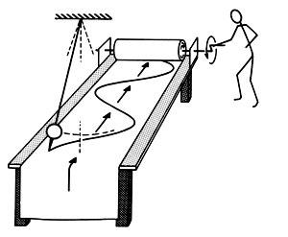
Interfacing to the Outside World
Why does it look like this? Nature normally appears as a sine wave.

Slide 4
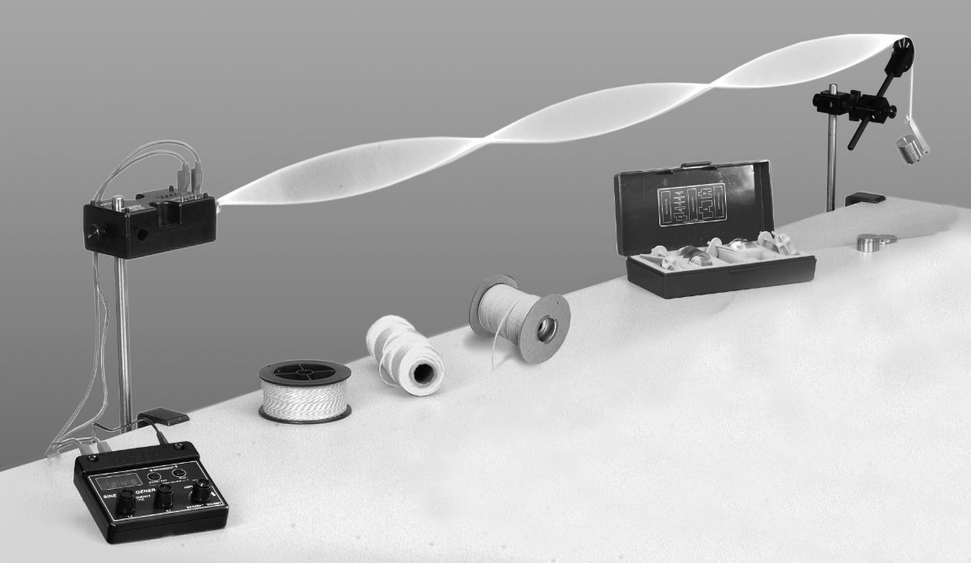
Interfacing to the Outside World
Why does it look like this? Nature normally appears as a sine wave.

Slide 5
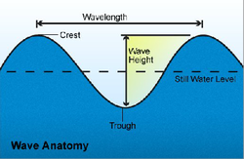
Interfacing to the Outside World
Wave in Distance

Slide 6
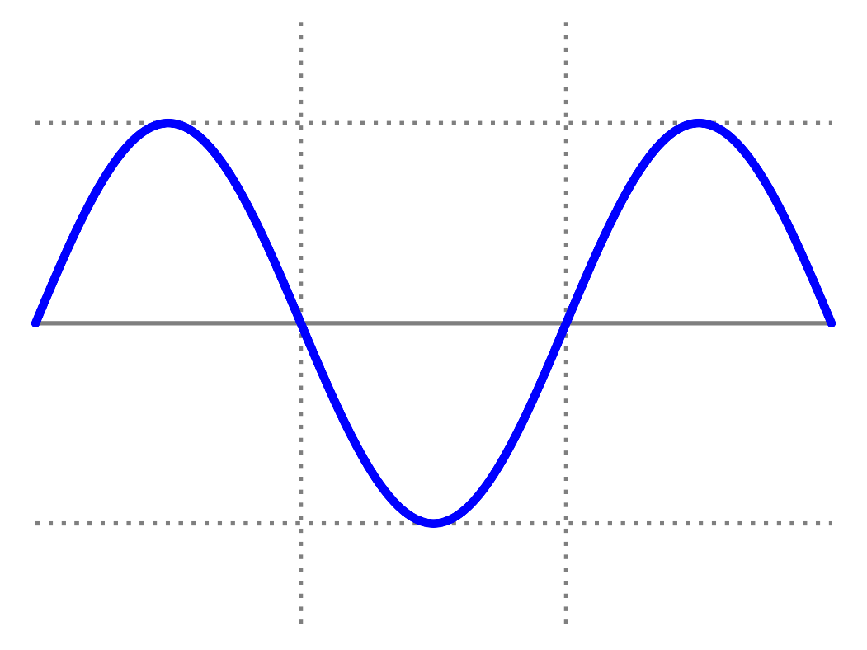
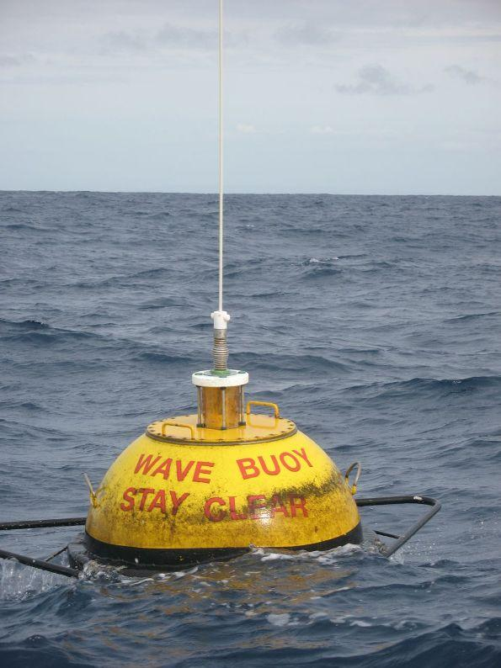
Wave in Time
height
time

Slide 7

Interfacing to the Outside World

Slide 8
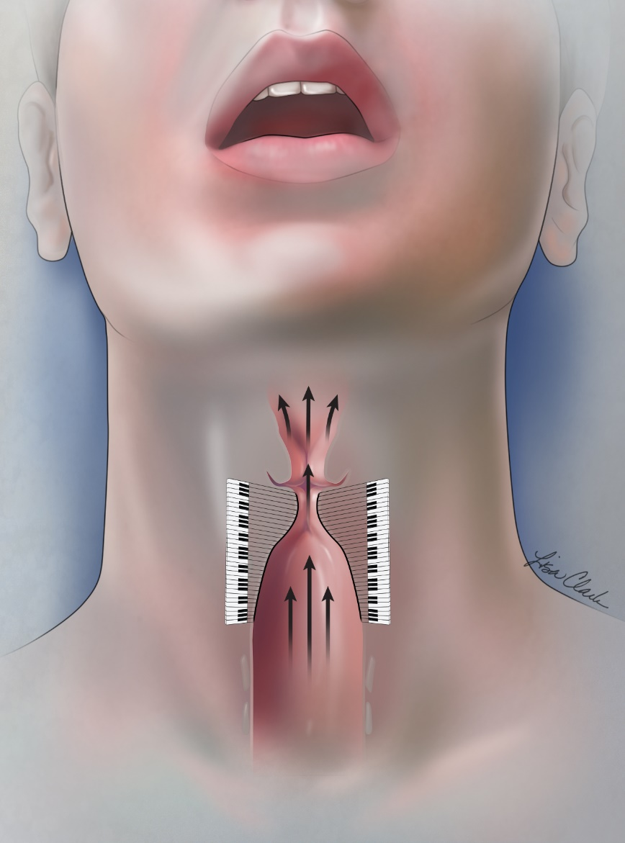
Interfacing to the Outside World

Slide 9
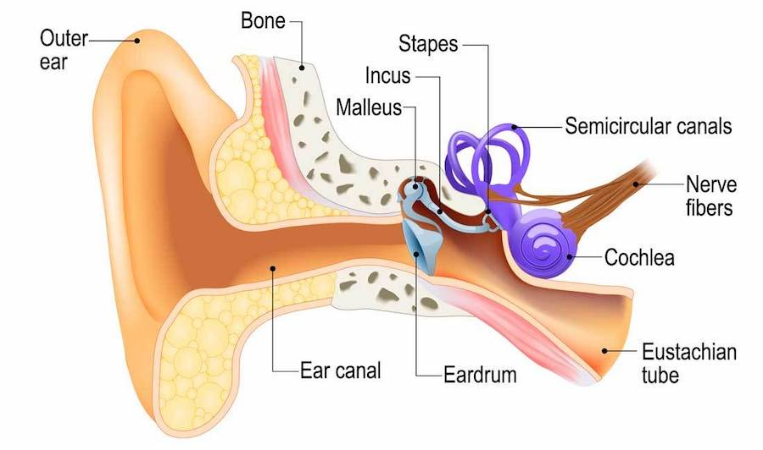
Interfacing to the Outside World

Slide 10
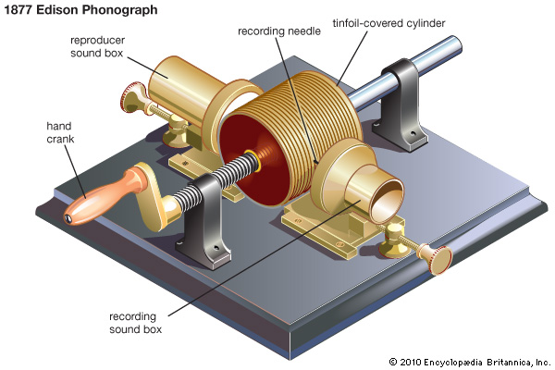
Interfacing to the Outside World
Creating this all Mechanically

Slide 11

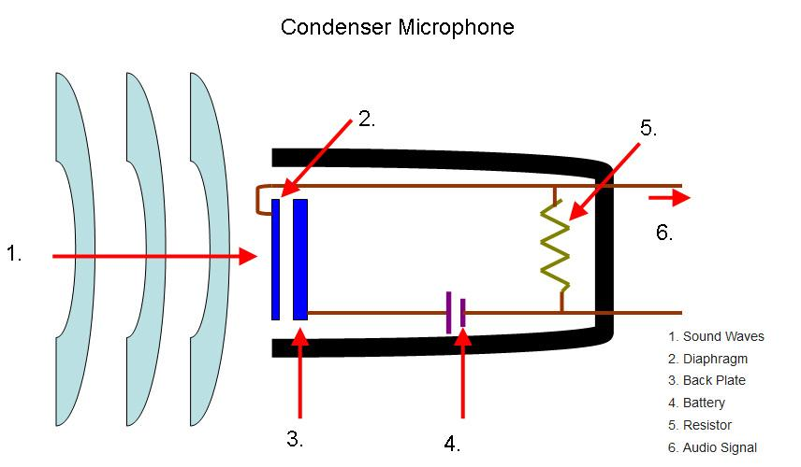
Interfacing to the Outside World
Creating this all Electronically

Slide 12
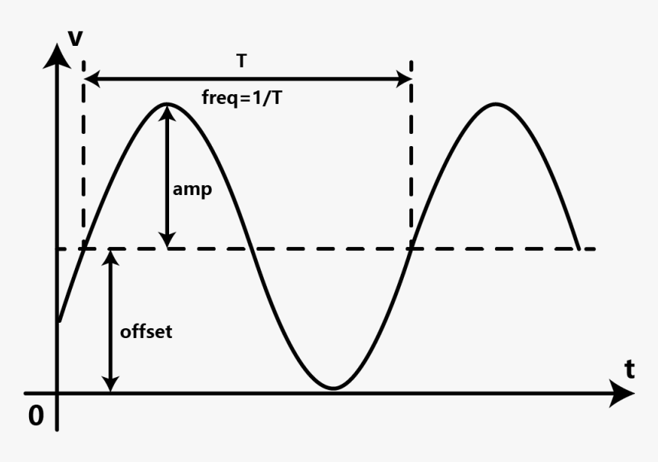
Interfacing to the Outside World
Creating this all Electronically

Slide 13
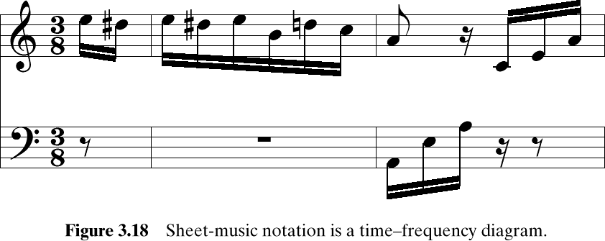
Fur Elise Waveform

Slide 14
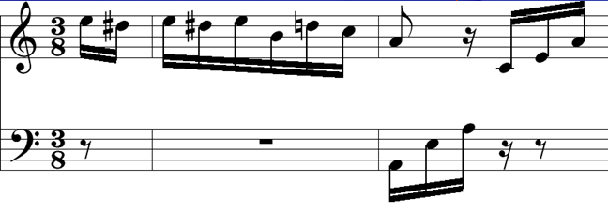
What does this represent?
A-440 Hz
Frequency is the vertical axis
Time is the horizontal axis
This is a Time-Frequency Diagram – One form of a Spectrum Diagram

Slide 15
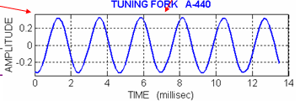
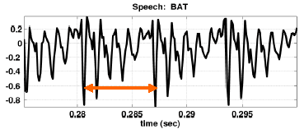
Sinusoidal Signals
Tuning Fork – Very Periodic
Bat Signal – Kinda Periodic in Vowel Region

Slide 16
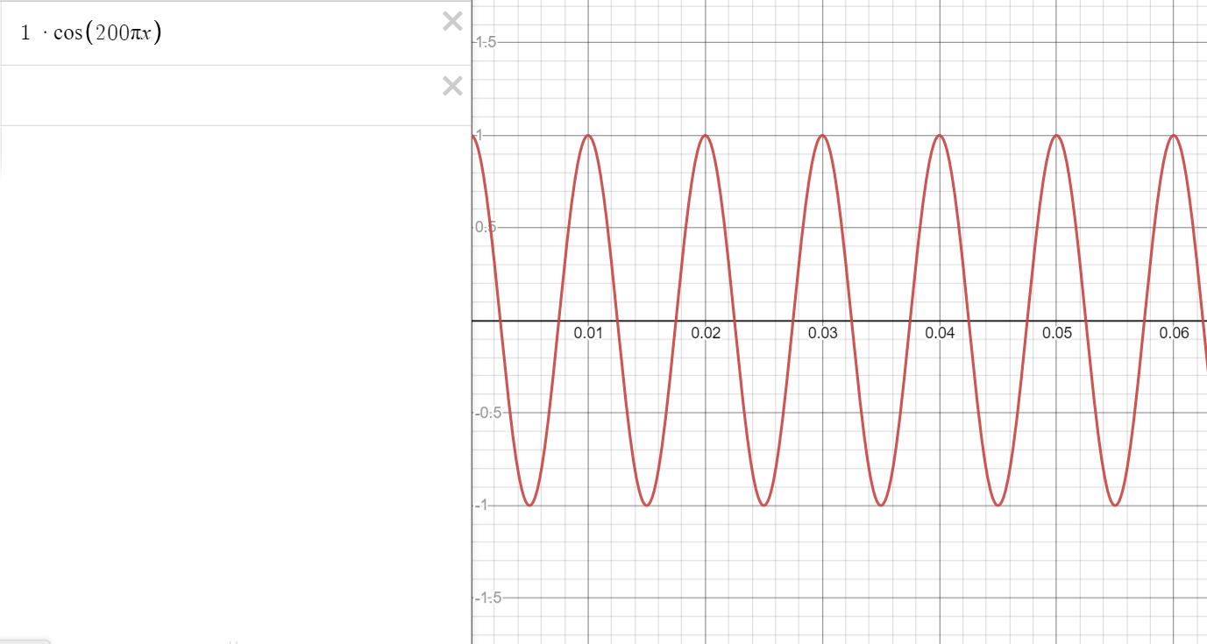
How do we represent this mathematically?

Slide 17
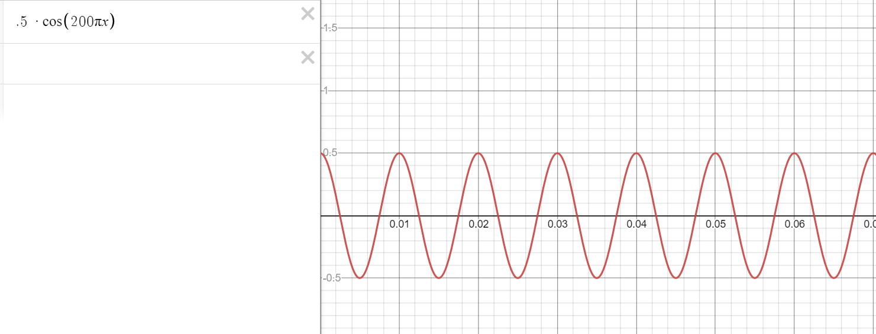
How do we represent this mathematically?

Slide 18
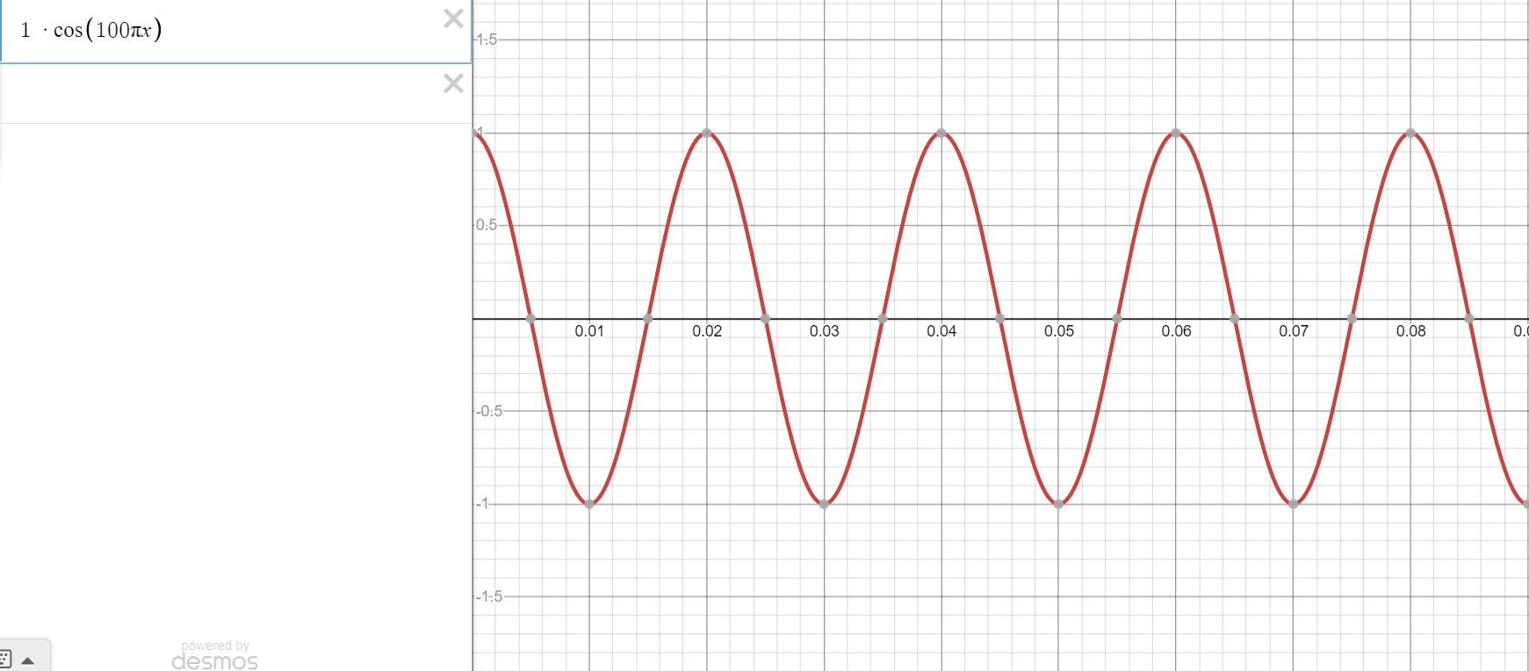
How do we represent this mathematically?

Slide 19
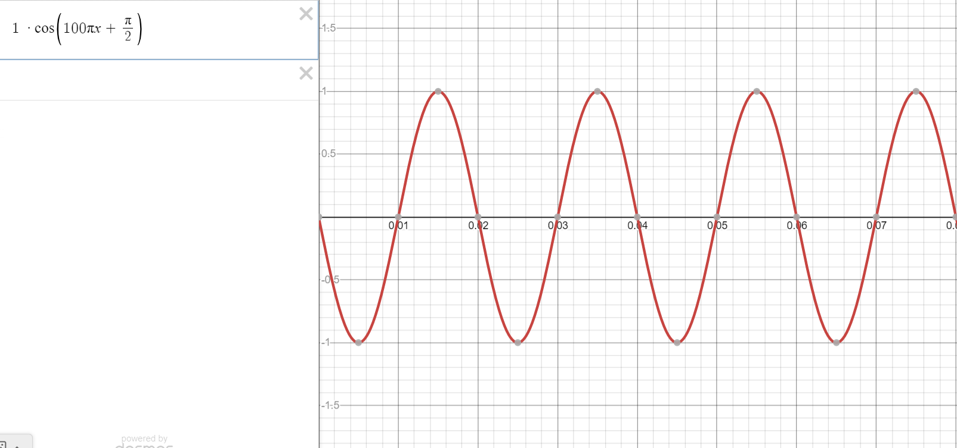
How do we represent this mathematically?

Slide 20
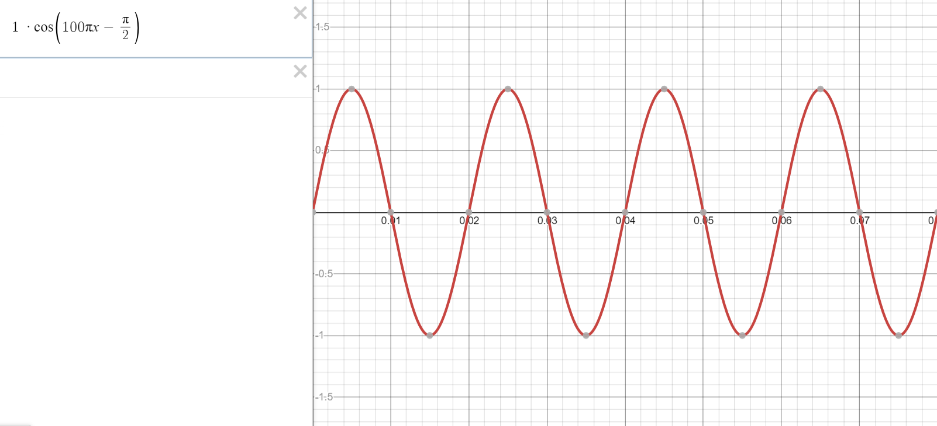
How do we represent this mathematically?

Slide 21
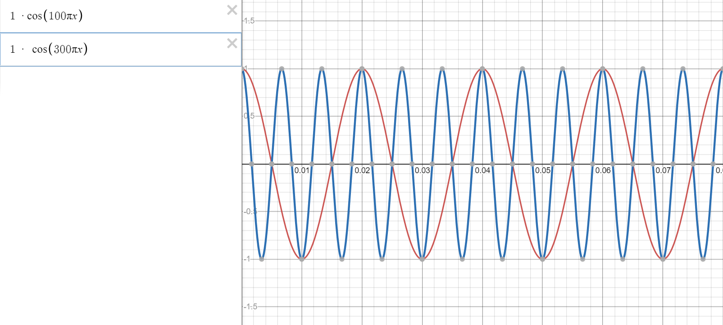
How do we represent this mathematically?

Slide 22
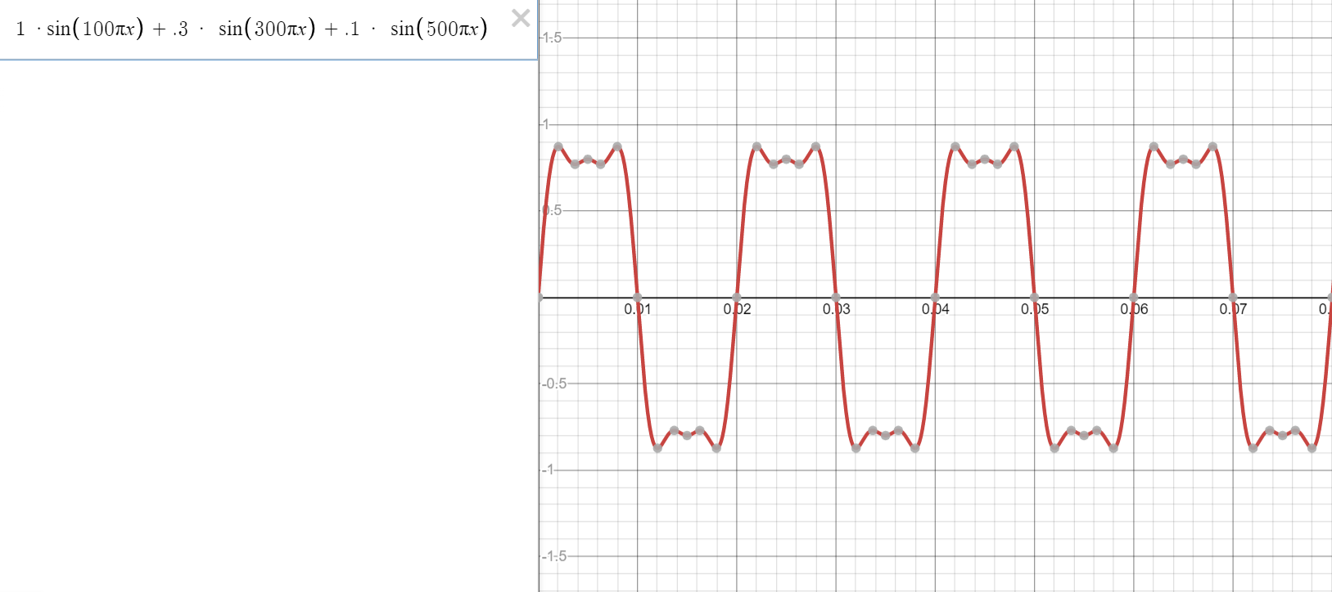
How do we represent this mathematically?

Slide 23
Sinusoidal Signals
Tuning Fork – Periodic Signal
A
0
880π
ω
This is another frequency diagram
Amplitude/Frequency diagram
Snapshot in time

Slide 24
Exponential Representation
Cosine = sum of 2 complex exponentials:
One has a positive frequency
The other has negative freq
Amplitude of each is half as big

Slide 25
2 Sided Spectrum Representation
-7
0
7
ω
Amplitude, Phase & Frequency are shown

Slide 26
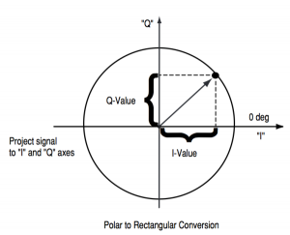
IQ – Vector Diagram

Slide 27
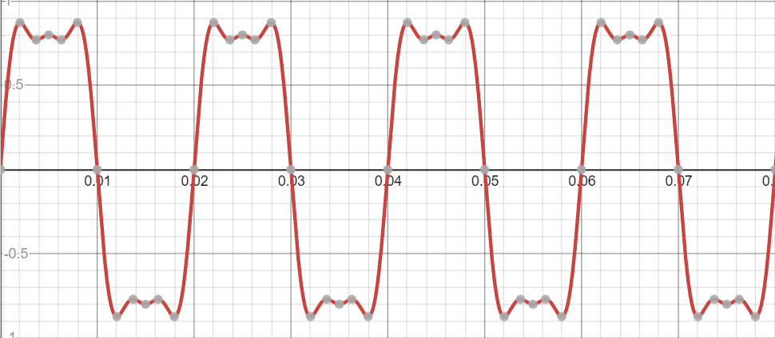
Interfacing to the Outside World
Creating this all Electronically

Slide 28
Interfacing to the Outside World
Creating this all Electronically
How do we relate the two signals?

Slide 29
Interfacing to the Outside World
Creating this all Electronically
How do we relate the two signals?

Slide 30
Interfacing to the Outside World
Creating this all Electronically
From the spec sheet
With 1 Pa RMS of sound (newtons per square metre or 94 dB sound pressure level, about the level of a person singing loudly) you will get -41 dB voltage out - that's approximately 8.9 mV RMS or .125 mVolts pk to pk
How do we relate the two signals?

Slide 31
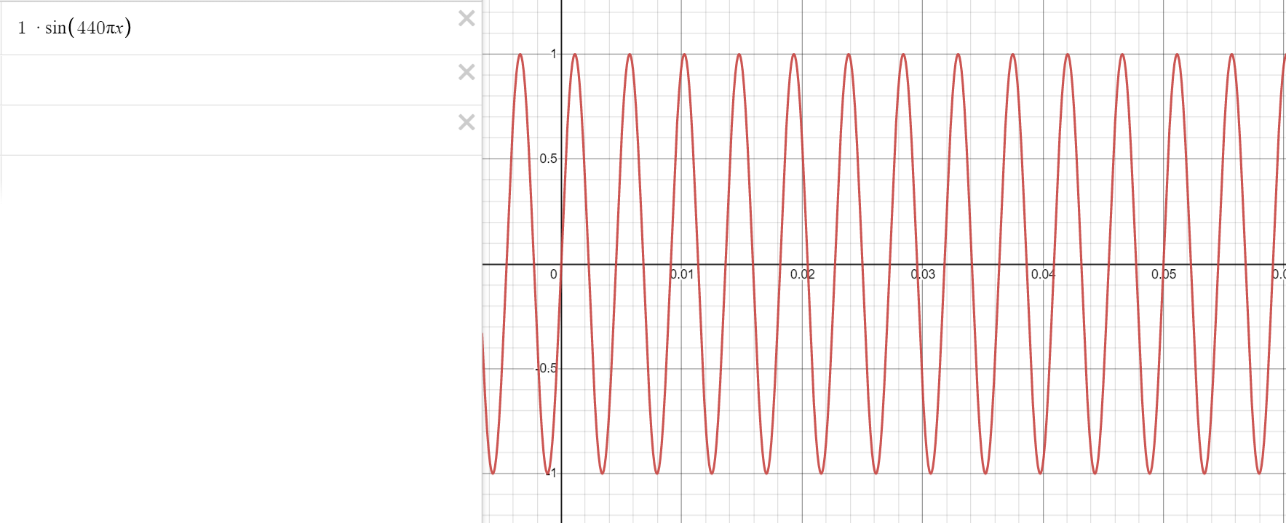
Interfacing to the Outside World
4 PA = 1 Volt
Creating this all Electronically
How do we relate the two signals?

Slide 32
Interfacing to the Outside World
Creating this all Electronically
4 PA
1 Volt
How do we relate the two signals?

